Slide 1


Integration of Food Nutrition Health and WASH (FNHW) in DAY-NRLM
Orientation of State Managers
National Mission Management Unit, Deendayal Antyodaya Yojana – National Rural Livelihoods Mission (DAY-NRLM)
Ministry of Rural Development, Government of India

Slide 2
Contents
Rationale for integrating FNHW in DAY-NRLM
Advisories on FNHW integration
Theory of Change
Strategic Pillars of FNHW strategy
Implementation structure and Role of State Managers

Slide 3
Rationale for integrating FNHW
DAY- NRLM is a flagship poverty alleviation programme of MoRD and mobilizes rural women in SHGs and its federations and provides opportunity to generate livelihoods.
Livelihoods and good health are inter- dependent - a healthy person is able to engage in livelihood activities to her/his full potential
Given its scope, vast social capital and its effectiveness, the DAY- NRLM is positioned as an effective platform to tackle the underlying causes of poor health and nutrition.

Slide 4
Multi-dimensional Poverty and Malnutrition
Income Poverty
Poor Purchasing Power / Education / Knowledge / Empowerment / Mobility
Poor Hygiene
Poor Sanitation
Lack of Water
Food and Nutrition Insecurity
Frequent Infections / Illness
High Exposure to Physical Labour
Poor Social Status of Women
Poor Knowledge on Maternal & Child care/ Feeding
Large families, Early Marriage
Poor Maternal & Child care
Increase in demand for Nutrients
Increase in requirement of diversified diet
Poor Nutrient Intake
Loss of Nutrients
Low Decision Making Power
Nutrient demand not met
MALNUTRITION
Direct Loss of productivity Poor physical Output
Indirect loss of Productivity Poor attendance at work/ school
Loss of Income/ resources High Investment in health care

Slide 5
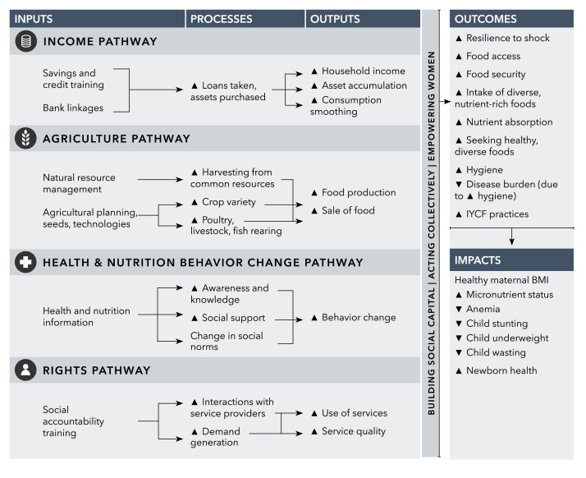
Conceptual pathways –
How women's groups can change health and nutrition
Source: https://www.ncbi.nlm.nih.gov/pmc/articles/PMC6004534/, Pathways from women's group-based programs to nutrition change in South Asia: A conceptual framework and literature review

Slide 6





Why integrate FNHW?
Proper Nutrition

Health Services

Increased savings
Overall wellbeing and improved quality of life
Appropriate Sanitation and Hygiene
Less Expenditure on Health/Diseases

Slide 7
Advisories on FNHW integration
In 2016, an advisory on Dashasutra was issued by MoRD (link 1 below to all States, which mandated that SHGs and VOs were to address and discuss issues relating to health and nutrition at every meeting.
To reduce expenditure on medical care, increase economic productivity and improve the quality of life of rural women and their families, necessary and appropriate FNHW interventions are to be promoted upfront.
In 2017, a Master Circular on FNHW (link 2 below) was issued to all States outlining the interventions and suggested modes of implementation.
In 2018, Joint advisory by MoWCD, MoRD and MoHFW (link 3 below) was issued indicating modalities of convergence and roles of functionaries of all the three departments to improve nutritional outcomes.
These interventions need to converge with the activities of the National Health Mission (NHM), Integrated Child Development Services (ICDS) and Swachh Bharat Mission (SBM) and others, primarily focus on generating demand for their services.
In 2020, an advisory by MoRD was shared on SBCC approaches to be adopted under FNHW component of DAY-NRLM (link 4 below)
In 2020, an advisory by MoRD was shared guiding the development of State FNHW Operational Strategy and functions of SRLM staff and cadres across administrative levels to deliver FNHW interventions was released.
1. https://drive.google.com/file/d/1oOlOSsY97aGnOtxStXjwHUYy7BVyBK98/view?usp=sharing
2. https://aajeevika.gov.in/sites/default/files/Master%20Circular%20for%20Food%2C%20Nutrition%2C%20Health%20and%20Wash%20Interventions.pdf
3. https://aajeevika.gov.in/sites/default/files/Joint%20Advisory%20on%20Nutrition.pdf
4. https://drive.google.com/file/d/1-pNEZtYKyPcaSwvGTsJZ1rLtZShzYHnT/view?usp=sharing

Slide 8
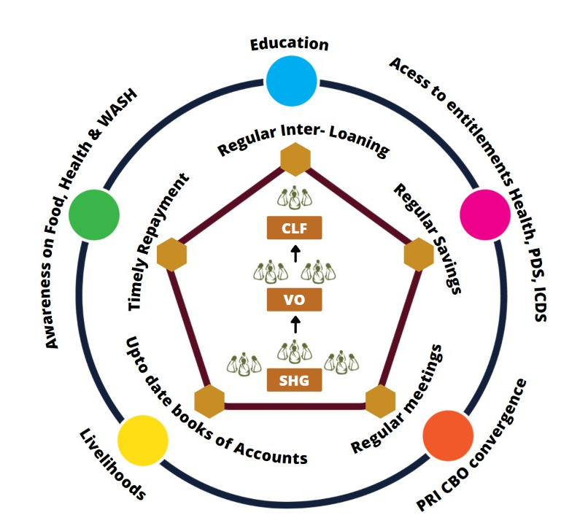
Dashasutra Strategy- 2016
Integrating livelihoods and social development for holistic growth of communities
Micro-credit and financing
Including social development - Food, Nutrition, Health and WASH, Gender etc.

Slide 9
FNHW: Under Dashasutra SHGs are required to:
Include social issues (including issues pertaining to Food, Nutrition, Health & WASH) that affect members as part of meeting agenda
Meetings should act as platform for discussion on health issues along with line agencies & PRI, invite ASHA & Anganwadi worker to their weekly meeting & benefit from their advice
Discuss malnutrition issues of women & children, pregnant & lactating mothers & facilitate their access to supplementary nutrition, healthcare & other entitlements
Every meeting should start with all members with washing hands
Discuss promotion of personal hygiene, food hygiene & prevention of open defecation
Each member should ensure that an individual sanitary toilet is built & used by all members of the household

Slide 10
FNHW: Opportunity for integration
Existing platform & extensive reach
Multiple points of contact
Working on agriculture, dairy, poultry & small ruminants
Working on financial products, social marketing & enterprise
Skilled manpower – Staff & Cadre
Ability to influence social norms, peer learning & influence
Focus on marginalized groups

Slide 11



FNHW Focus Areas
FOOD
Nutri-Garden
Access to PDS
Access to THR
Mid Day Meal
FNHW Enterprises
HEALTH & NUTRITION
Antenatal Care | Anemia reduction
New Born Care | Family Planning
1000 Days | Health & Nutrition for the Elderly and PWD
Infant and Young Child Feeding | Nutrition and Health during NCDs
Maternal Nutrition | Menstrual Hygiene
Family Diet diversity
WASH
Use of sanitary toilet
Handwashing practices
Management of household waste

Slide 12
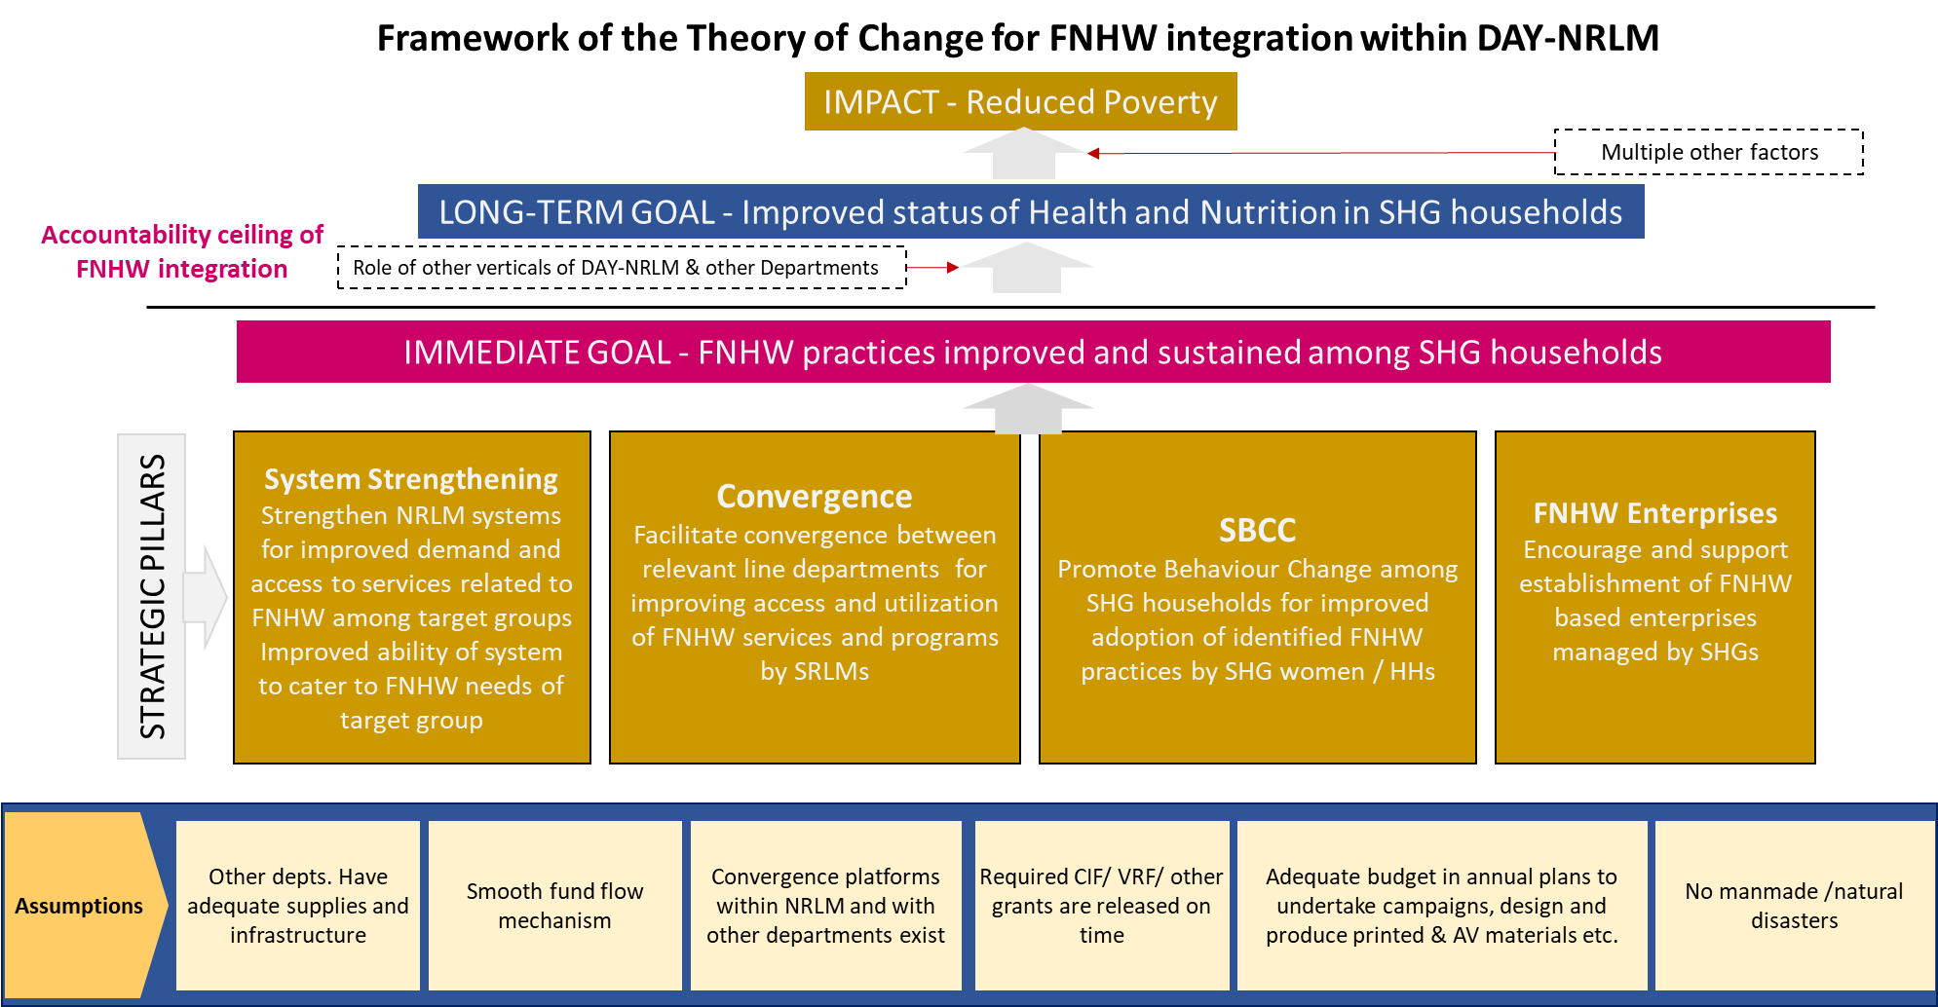
Theory of Change for FNHW integration within DAY-NRLM

Slide 13
Strategic Pillars
System Strengthening
Convergence
FNHW Enterprises
SBCC
Encourage and support establishment of FNHW based enterprises managed by SHGs
Improved ability of the system to integrate FNHW, and cater to needs of the target group for increased demand and access to FNHW related services
Promote behavior change among SHG households for improved adoption of FNHW practices
Facilitate convergence between relevant line departments for improving access and utilization of FNHW services and programs by SHG households

Slide 14
Overview of the Strategic Pillars
System strengthening (improved ability of the system to integrate FNHW)
Convergence (convergence with line departments and SRLM verticals for improved services)
SBCC (promoted behavior change among SHGs)
FNHW Enterprise (established FNHW enterprises managed by SHGs)
Identify FNHW nodal person Form core committee Develop strategy, guidelines, SOPs and other documents Develop resource pool Design special packages of services and resource materials Decide training cascade and undertake capacity building for SRLM nodals at state, district, block, CLF, VO and SHG levels. Establish schedule of reporting, review and monitoring
Modify job description of concerned staff and cadre Decide on lead, participants, schedule and frequency of convergence meetings Conduct and regularize convergence meetings - with other verticals - with line departments Support programs of other ministries
Develop/adapt and roll out SBCC strategy and package of practices/tools (modules) Organize/participate in VO level events/campaigns to bring out behaviour change in community Undertake home visit, peer counselling and mobilize target groups to attend VHSNDs and community events like Annaprashan Diwas and Godbharai. Develop/adapt tools and materials for SBCC and other activities for reaching out to the target group
Identify FNHW needs and suggest enterprises to cater to the needs of the community Promote enterprises relevant to target group - goatary/poultry/ FNHW enterprises etc. Promote utilization of FNHW enterprise products Share learning from successful enterprises

Slide 15
Pillar 1 - Systems Strengthening
Form and functionalize a state-level FNHW core committee, with representatives of different line departments and other verticals of SRLM as members. This will be headed by the CEO / SMD.
Develop / modify State FNHW Operational Strategy with budgetary provisions in the State Annual Action Plan.
Issue advisories, circulars and other necessary guidance documents
Clearly define roles and responsibilities of staff and cadres for FNHW
Create pool of state level resource persons
Orient/build capacity of state, district, block level staff and other cadres
Facilitate exposure visits of SRLMs to NRO and other mature states.
Facilitate convergence within SRLM verticals and with line departments
Establish review, reporting, monitoring and evaluation mechanisms and protocols
Develop a mechanism to provide feedback to districts and blocks based on data analysis
Requisites to rolling out FNHW interventions
In 2020, Jeevika Bihar was designated as National Resource Organization (NRO) for FNHW. States can request need based support in FNHW implementation……link to NRO ToR

Slide 16



Suggested Cascade for FNHW Capacity Building
Training Plan
The training will comprise of technical and operational sessions. Each session will be a stand-alone capsule to enable SRLM to pick up topics based on state strategy.
Mater Trainers (NMMU, Partners, NIRD, NRP)
SRP
DRP
BRP
SIRD
1
Develop pool of master trainers at state level
Specific requirements
Form trainer resource pool at the state level and each intervention district and block
Print and distribute contextualized training module and IEC material including posters, flip charts, videos etc.
Orient staff/trainer resource pool/cadre of district and block on FNHW (Flip Book and SOPs)
Develop training cascade and flow of FNHW session rollout based on state strategy
State level Trainers
CRP
CRP
2
Orientation of district and block level managers
Community level Trainers
Vo leaders
SAC members
Community cadre/Active women
3
Capacities of CRPs / VO leaders/VOA’s SAC members are built
Trainers of SHG members
4
Monthly meetings with SHG members to orient them on FNHW sessions
SHG women

Slide 17
Resources available for orientation and building capacity of state, district, block level and other cadres
Orientation material for state, district and block managers and CBOs
Handouts
Standard Operating Procedures for –
FNHW Action Planning
Review
Convergence
Home visit
Peer Counselling
Participation in VHSND
Organizing Community events / campaigns
Parivar Chaupal
Reward mechanism
Formats and Templates for operationalization
Facilitator Guides and Flipbooks on technical content for Trainers and SHGs

Slide 18
Establishing the State FNHW MIS system
Planning
Form a team of relevant stakeholders, set the objectives of the MIS and identify key indicators
Identify flow of data, data collection levels, data collection teams, trainers and review mechanisms
Develop data collection formats for each data collection level (for e.g. FNHW CRPs/ VO SAC/VOA)
Identify inhouse capacity/external agency to develop data collection tools/software and MIS dashboard
Develop data collection application (phone/online), Develop a web/application based dashboard
Execution
Test the MIS system in select geography (e.g. a few VOs) and make modifications based on test results
Conduct an orientation of state, district and block team on the MIS
Train Master Trainers (MTs) who will subsequently train the data collection teams
Initiate data collection. MTs to provide handhold support to the data collection team
Review
Implement review mechanisms (e.g review at block district and state level based on the dashboard)

Slide 19
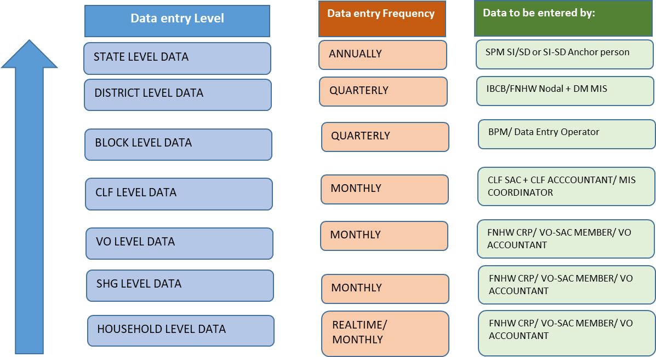
Review and Reporting of FNHW
Review and Reporting Mechanism

Slide 20
MIS and Review of FNHW
Suggested Indicators
# | Indicators
Progress of FNHW Interventions | Progress of FNHW Interventions
1 | # of target beneficiaries in SHG HHs in the reporting month (pregnant women/lactating women/adolescents/elderly etc.) | # of target beneficiaries in SHG HHs in the reporting month (pregnant women/lactating women/adolescents/elderly etc.)
2 | % SHGs conducted monthly meeting on FNHW | % SHGs conducted monthly meeting on FNHW
3 | % SHGs oriented on FNHW modules | % SHGs oriented on FNHW modules
4 | % SHG women oriented on FNHW modules | % SHG women oriented on FNHW modules
5 | % VOs organized community events on FNHW (campaigns/rallys/competitions etc.) | % VOs organized community events on FNHW (campaigns/rallys/competitions etc.)
6 | % VOs participated in VHSNC/JAS/RKS meeting | % VOs participated in VHSNC/JAS/RKS meeting
7 | # of VO running an FNHW enterprise | # of VO running an FNHW enterprise
8 | # of CLFs running an FNHW enterprise | # of CLFs running an FNHW enterprise
HR recruitment and capacity building | % of FNHW CRPs recruited (against sanctioned) | HR recruitment and capacity building
9 | % of FNHW CRPs recruited (against sanctioned) | % of FNHW CRPs recruited (against sanctioned)
10 | % of FNHW CRPs trained in FNHW modules (against recruited) | % of FNHW CRPs trained in FNHW modules (against recruited)
11 | % of VO SAC trained on FNHW | % of VO SAC trained on FNHW
12 | % of CLF SAC trained on FNHW | % of CLF SAC trained on FNHW
# | Indicators | Indicators
Update on systems for FNHW
13 |  | Does the state have an FNHW core committee
14 |  | # of districts under intensive FNHW strategy
15 |  | # of blocks under intensive FNHW strategy
16 |  | State organized a convergence meeting (with NHM, WCD, Farm Livelihoods and others) ?
17 |  | States submitted convergence meeting minutes to NRLM ?
18 |  | # of districts had a convergence meeting
19 |  | # of blocks had a convergence meeting
20 |  | % VOs reviewed by FNHW CRP
21 |  | % CLFs reviewed by BPM/CC
22 |  | % Blocks reviewed by DPM/DMM
23 |  | % Districts reviewed by CEO/SMD
Include any other indicator as synthesized in State FNHW Operational Strategy

Slide 21
Review FNHW activities
FNHW agenda should be included in the regularly scheduled review meetings
A separate dedicated FNHW meeting should also be held at the state level.
Suggested Schedule for review
Level | Undertaken by | Participants | Frequency
State | CEO/SMD/FNHW Core Committee | SPMs of other SRLM verticals | Monthly
 | CEO/SMD/SPM (FNHW Incharge) | District Program Managers (DPMs)/District Managers (DMs) (FNHW Incharges) | Monthly
District | DPM/DM (FNHW In-charge) | Block Program Manager (FNHW In-charge) | Monthly
Block | Block Program Manager (FNHW Incharge) | CLF Leader/ SAC Members/OB/EC | Monthly
CLF | CLF Leader/SAC Members/OB/EC | VO Leader/SAC Members/CRP | Monthly
VO | VO Leader/SAC Members/CRP | SHG Leaders/Point person | Monthly
Objectives
To assess progress of FNHW activities against strategy and timelines
To identify challenges and bottlenecks in the implementation process
Identify solutions and discuss deliverable timeline for revised activities, if any
Note: States may modify the schedule and protocol based on their State implementation structure.

Slide 22
Pillar 2 - Convergence
Core Committee is responsible for establishing convergence platforms at state, district and block levels through bi-annual / quarterly meetings with line departments and SRLM verticals
  Schedule convergence meetings and coordination with other verticals (IB-CB, Gender, FI, Livelihood- Farm and Non-Farm etc.)
  Schedule convergence meetings in coordination with line ministries / departments (Health, WCD, PRI, Jal Shakti, Ministry of Consumer Affairs, Food and public Distribution, Education, Agriculture and SBM etc.)
Issue state circulars to districts for supporting and organizing events as envisioned by other ministries, such as Poshan Abhiyaan, Swachha Bharat, Fit India, etc
Mapping of partners / agencies / institutes and forging partnership for FNHW integration
Convergence
A Joint advisory on convergence with WCD and NHM has been issued https://aajeevika.gov.in/sites/default/files/Joint%20Advisory%20on%20Nutrition_2.pdf

Slide 23
Possible areas of Convergence
Focus areas | Within DAY-NRLM | With other departments/ministries
Food and Nutrition | Farm Livelihoods Nutri-garden/poultry/goatary Non-Farm Livelihood FNHW enterprises | Department of Food and Public Distribution System Public Distribution System (PDS) Department of Women and Child Development Integrated Child Development Services- Take Home ration (THR), growth monitoring and Early childhood care and pre-school education, POSHAN Abhiyaan Pradhan Mantri Matru Vandana Yojna (PMMVY) Department of Education Mid Day Meal (MDM) Mahatma Gandhi National Rural Employment Guarantee Scheme (MGNREGS)
Health | Financial Inclusion Access to health/life/accident insurance Institution Building-Capacity Building Use of Vulnerability Reduction fund (VRF) | Department of Health and Family Welfare National Health Mission- Anaemia Mukt Bharat, Village health Sanitation and Nutrition Days (VHSND), Universal Immunization Program (UIP), Surakshit Matritva Aashwaasan (SUMAN), Pradhan Mantri Surakshit Matritva Abhiyaan (PMSMA), Janani Suraksha Yojna (JSY), Janani Shishu Suraksha Karyakram (JSSK) Ayushman Bharat- Health and Wellness Centre and Pradhan Mantri Jan Arogya Yojna (PMJAY) Ministry of Finance Pradhan Mantri Suraksha Bima yojna (PMSBY)
WASH | Financial Inclusion SHGs take loans for WASH activities | Swachh Bharat Mission Toilet construction Solid liquid waste management Jal Jeevan Mission
Adapted from Master Circular for FNHW

Slide 24
Convergence with SRLM verticals and line departments
Coordinate with functionaries of line departments (Health, WCD and PRI etc.) to improve uptake of FNHW services and entitlements.
Suggested Schedule of Convergence Meeting
Level | Coordinator | Participants | Frequency
State | CEO/SMD/SPM (FNHW Incharge) | State-level representatives from line departments | Biannual
 | CEO/SMD/SPM (FNHW Incharge) | SRLM vertical heads | Quarterly
District | District Program Manager (FNHW In-charge) | District-level representatives from line departments | Quarterly
Block | Block Program Manager (FNHW In-charge) | Block-level representatives from line departments | Quarterly
CLF | CLF Leader /SAC/OB/EC | Supervisor and ANM, PRI members | Quarterly
VO | SAC/CRP | ANMS, ASHA and AWW, PRI | Monthly
Objectives
To identify areas of convergence and prominent issues therein
To prioritize issues and suggest mitigating measures
To identify relevant stakeholders and assign responsibility
To decide on a timeframe for resolution and escalate issues
Note: States may modify the schedule and protocol based on their State implementation structure.

Slide 25
Pillar 3 – Social Behavior Change Communication
It is important to integrate SBCC approach in the overall FNHW strategy for required changes in behaviors and practices
SBCC is also critical to promote utilization of FNHW services and increase demand for quality service
Develop/adapt supporting tools and materials for SBCC and other activities for reaching out to the target group
Build capacity of SRLM nodals across all levels/CLF/VO/SHG
Decide on cascade for roll out of SBCC sessions-frequency, order and follow-up
Use of varied communication channels to promote right knowledge and practices on FHNW services & entitlements
SBCC
Details and approach for SBCC suggested in the advisory issued in 2020
https://drive.google.com/file/d/1-pNEZtYKyPcaSwvGTsJZ1rLtZShzYHnT/view?usp=sharing

Slide 26
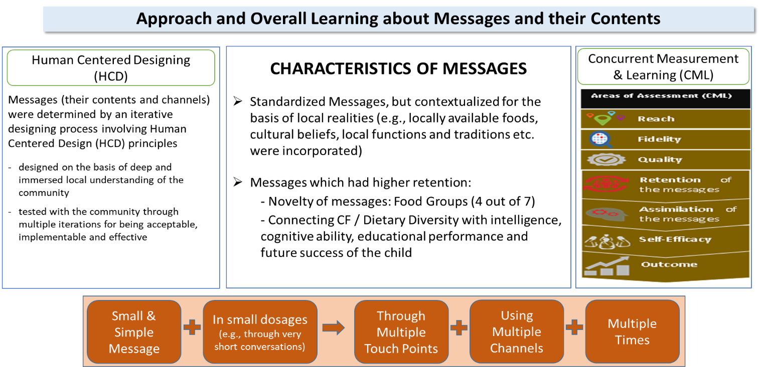
Approach for Behavior Change
Source – SBCC advisory to SRLMs

Slide 27
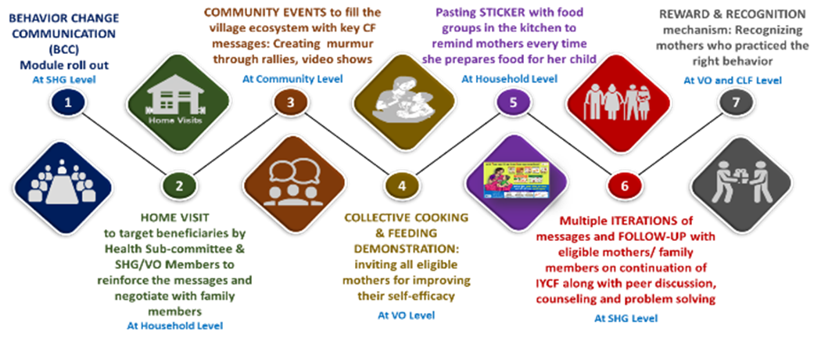
Multiple touch points are very effective

Slide 28
Bringing Social Behavior Change in the Community
FNHW package available for SBCC
Facilitator Guide – to facilitate trainers in rolling out sessions on FNHW
Flipbooks for SHG members – to be used during SHG monthly meetings
IEC Materials for home visits, community events and other activities
  Posters – for display during community events and awareness generation
  Banners – for events like campaigns and rallies
  Stickers – to serve as reminders on key messages
  Counselling Cards – to be used during home visits and smaller interactions
Recommended for rollout in a cascade mode as described earlier
Use of package in the state by prioritizing themes, contextualizing, translation, phase wise use and implementing

Slide 29



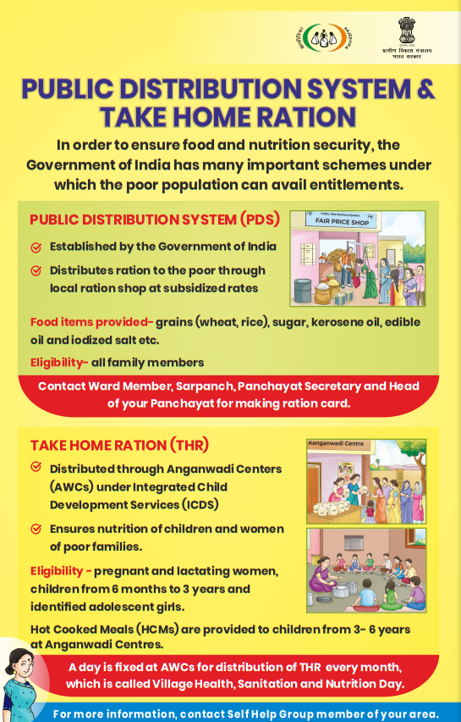
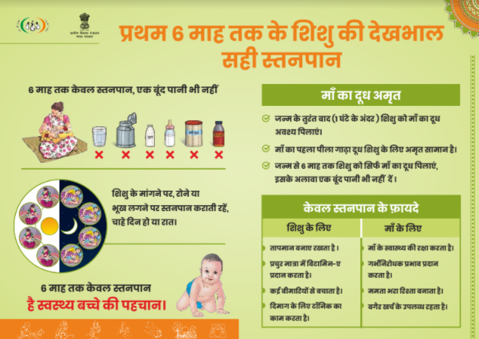

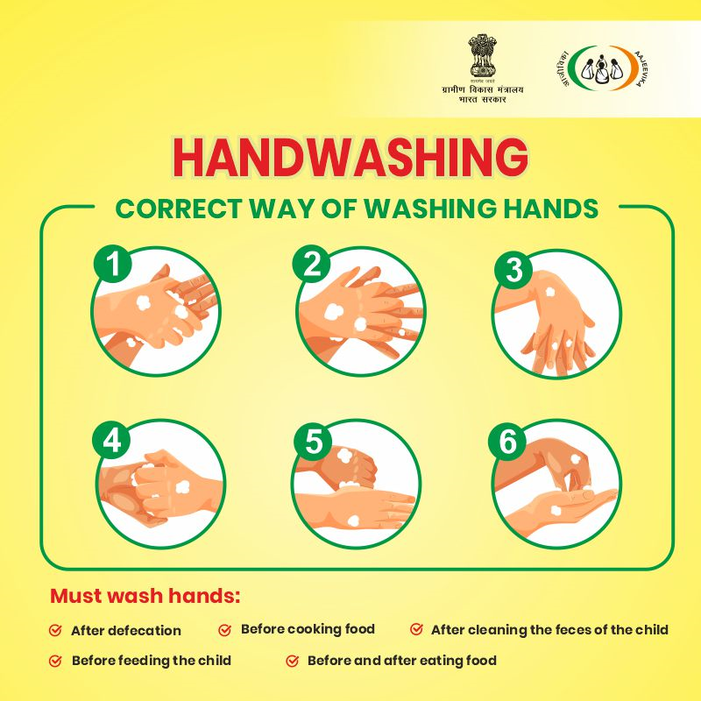
Sample of materials developed to support FNHW integration

Slide 30
Pillar 4 - FNHW Enterprise
Any enterprise related to product or service within FNHW category such as Take Hone Rations, sanitary napkins, nutri mix, etc are to be promoted in the state.
The demand/requirement of the product/service must emerge from and contribute to the health and nutrition situation of the respective geography
The enterprises must be led either by individual SHG women or by community institutions under the SRLM umbrella
The enterprise initiative should be in collaboration with the Farm and Non Farm vertical that has issued an advisory to support enterprises – link below
Efforts should be for promoting more remunerative models (focus on generating demand, creating awareness for usage of the product along with income generation) for better nutrition and health outcomes, of FNHW enterprises
Issue necessary circulars, guidance and communication to facilitate establishment and operationalization of FNHW enterprises
FNHW Enterprise
https://aajeevika.gov.in/sites/default/files/Advisory%20on%20supporting%20Enterprises.pdf

Slide 31
Facilitate promotion of FNHW enterprises
Encourage and support establishment of FNHW enterprises managed by SHGs (individual/collectives) such as Take Home Rations, sanitary napkins and nutri-mix etc.
Role of State Nodal Managers
Identify geographies based on existing enterprise initiatives and interest at district / block level
Coordinate with Farm/Non-Farm vertical to prioritize establishment of such enterprises
Identify need for kind of circulars/guidance/communication required to facilitate their establishment and operationalization
Develop strategies for promoting consumption of FNHW products, to share with district / block.
Develop convergence mechanisms with other verticals for enterprises for district and block levels
Efforts should be for promoting more remunerative models (focus on generating demand, creating awareness for usage of the product along with income generation)
FL vertical has issued an advisory to support enterprises – https://aajeevika.gov.in/sites/default/files/Advisory%20on%20supporting%20Enterprises.pdf

Slide 32
Implementation Structure across Levels for Operationalization of FNHW
SHG Level HR
VO Level HR
CLF Level HR
State Mission Management Unit
District Mission Management Unit
State Programme Manager SI & SD
Program Manager, State Resource Person/Master Trainers
District Programme Manager IB-CB, District resource pool
Block Mission Management Unit
Social Action Committee (consisting 5 members)
Office Bearers/ Executive Committee
Block Programme Manager, resource pool
Social Action Committee (consisting of 3 members)
Community Resource Person (CRP)
FNHW Nodal(Community Mobilizer/Active Woman etc.)
Note: The above implementation structure is suggestive. States may modify this as per their State FNHW Operational Strategy.

Slide 33
Roles and Responsibilities of State Managers
National level support
Coordinate with NMMU for FNHW related information, guidance and other requirements. Keep track of all advisories and other FNHW related policy documents and take action accordingly
Report to NMMU on FNHW progress as per prescribed reporting system
Develop State Annual Action Plans for FNHW interventions
Coordinate at the State level with other line departments and SRLM verticals
Support District Mission Management Unit (DMMU) in FNHW implementation
  Release of necessary guidance and circulars to guide district and block level officials
  Organize trainings for downward chain of staff (district level staff and resource persons)
Undertake monitoring visits to districts and blocks
Manage state FNHW budget and expenditure
Document learnings and best practices
Review FNHW implementation of districts and blocks and support them in establishing review mechanisms
Support and coordinate for establishment of FNHW enterprises in convergence with Farm Livelihood vertical in identified geographies
State level role
District / Block level support

Slide 34
State FNHW Operational Strategy
01
State FNHW strategy objectives
02
Expected outcomes
03
Target population
Outlined Strategies
For convergence
For implementation
For review and monitoring
04
05
Partnerships within the state
Note: State specific details need to be filled here from their Operational Strategy

Slide 35
This presentation can be used to orient FNHW core committee members

Slide 36
Reiterate with the FNHW core committee
Collaboration areas with other SRLM verticals
Convergence points with other line departments
Discussion on FNHW implementation and progress
Evaluation protocol and planning
Any innovation proposed
Scaling up and expansion of FNHW interventions and timeline
Budgetary provisions and utilization on common interventions

Slide 37
Thank You!

